Slide 1

DoRev: AI-Powered Google Review Manager
Anas Chougle - (23207006)
Asma Rajguru - (23207005)
Arju Salmani - (22107003)
Yash Nalawade - (22107058)
Project Guide
Mr. Praveen Shinde
Notes:
1
1

Slide 2
Outline
Introduction
Literature Survey of the existing systems
Limitations of the existing systems
Problem statement
System Design
Technologies and methodologies
Implementation
Conclusion
References
Notes:
2
2

Slide 3
Introduction
The AI Google Review Manager offers businesses a smarter way to manage customer feedback. By scanning a QR code, customers can easily share their reviews, which are then automatically analyzed and categorized using AI. This streamlines the process of managing reviews, helping businesses highlight meaningful and constructive feedback while filtering out negative content.
Motivation
Handling customer reviews can be overwhelming, especially when sorting through large volumes of feedback and dealing with negative comments that can harm a brand’s reputation. The AI Google Review Manager addresses these challenges by automating the analysis and filtering process. It ensures businesses showcase high-quality reviews, gain valuable insights from customer feedback, and maintain a strong brand reputation with minimal effort.
Notes:
3
3

Slide 4
Objectives
To improve review management efficiency by automating the analysis and classification of customer feedback using an NLP-based sentiment analysis model trained on a Kaggle dataset.
To enhance review quality by ensuring only positive and constructive feedback is published using a sentiment analysis model.
To facilitate insightful analysis by visualizing customer feedback through a comprehensive dashboard using ReactJS and Tailwind CSS.
To protect brand reputation by automatically filtering toxic and harmful reviews using NLP-based toxicity detection.
Notes:
4
4

Slide 5
Literature Survey of the existing system
SR. NO | TITLE | AUTHOR | YEAR | OUTCOMES | METHODOLOGY | RESULT
1. | Restaurant Reviews Analysis Model Based on Machine Learning Algorithms[1] | Yan Jiang | 2021 | Developed a machine learning-based sentiment analysis model for restaurant reviews, improving decision-making for businesses and customers. | Used NLP, Sentiment Analysis, and Machine Learning (Supervised, Unsupervised, Reinforcement Learning) to classify and predict customer sentiments. | Enhanced review accuracy, reduced bias in ratings, and improved restaurant business strategies.
Notes:
5

Slide 6
Literature Survey of the existing system
SR. NO | TITLE | AUTHOR | YEAR | OUTCOMES | METHODOLOGY | RESULT
2. | Modelling the Impact of Hotel Facilities on Online Hotel Review Score for City of Skopje[2] | Marija Stojchevska, Andreja Naumoski, Kosta Mitreski | 2022 | Analyzed the relationship between hotel facilities and online review scores in Skopje. | Used ArcGIS software to analyze data from 80 hotels on Booking.com and TripAdvisor, relating review scores to 20 different hotel facilities.. | Found that certain facilities, like soundproofing and free parking, significantly influence hotel review scores, especially for 3 and 4-star hotels.
Notes:
6

Slide 7
Literature Survey of the existing system
SR. NO | TITLE | AUTHOR | YEAR | OUTCOMES | METHODOLOGY | RESULT
3. | Word Cloud of Online Hotel Reviews in Myanmar for Customer Satisfaction Analysis[3] | Phasit Charoenkwan | 2023 | Identified key factors influencing hotel customer satisfaction/dissatisfaction in Myanmar. | Analyzed 682 online reviews from TripAdvisor using word cloud and clustering techniques. | Satisfaction: Room, staff, pool, view, food. Dissatisfaction: Room cleanliness, internet, staff..
Notes:
7
7

Slide 8
Limitations of existing systems
Manual Review Handling: Businesses have to manually sort and analyze customer feedback, making the process time-consuming and prone to errors.
Poor Sentiment Analysis: Many systems cannot accurately interpret the tone and content of reviews, leading to unreliable insights and missed opportunities for growth.
Inconsistent Review Quality: Limited filtering allows harmful or irrelevant reviews to remain visible, affecting the business's reputation and reducing the usefulness of feedback.
Lack of Actionable Insights: Existing platforms often lack advanced analytics, making it difficult for businesses to extract meaningful information to improve services and customer experiences.
Notes:
8
8

Slide 9
Problem statement
Managing Google reviews manually is time-consuming and often results in businesses overlooking important customer feedback. This makes it difficult to handle large volumes of reviews efficiently.
Many existing systems do not effectively analyze the tone and meaning of reviews, leading to poor insights and difficulty in distinguishing helpful feedback from harmful or irrelevant content.
Toxic or irrelevant reviews can harm a brand’s reputation, while businesses miss out on valuable insights due to the lack of advanced analytics. An automated solution is needed to streamline review management and support better decision-making.
Notes:
9

Slide 10
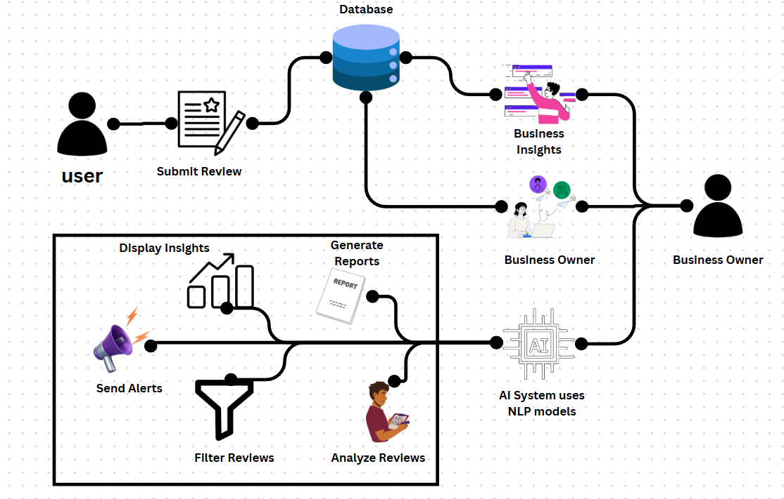
System Design

Slide 11
Technologies and methodologies
Front-End:
ReactJS
Tailwind CSS
Back-End:
TypeScript
Algorithm:
NLP (Sentiment Analysis)
Deepseek Chatbot
DataSet:
Sentiment Analysis from kaggle
Notes:
11
11

Slide 12
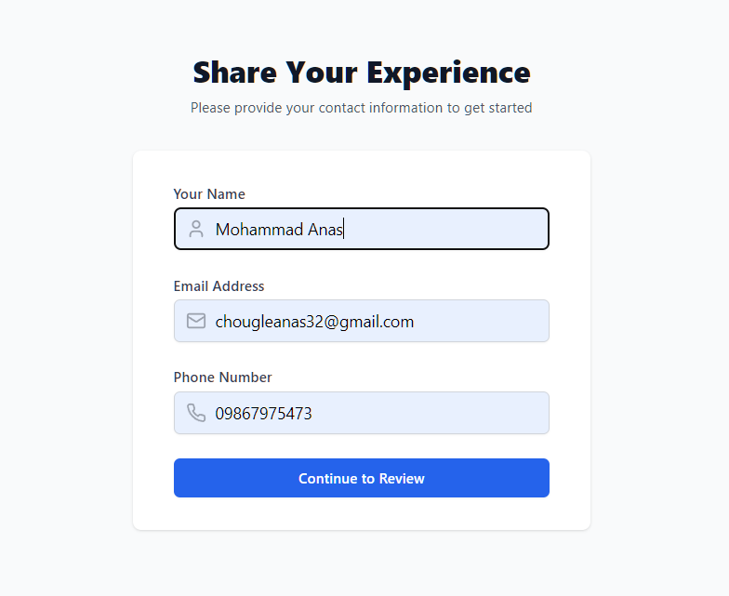
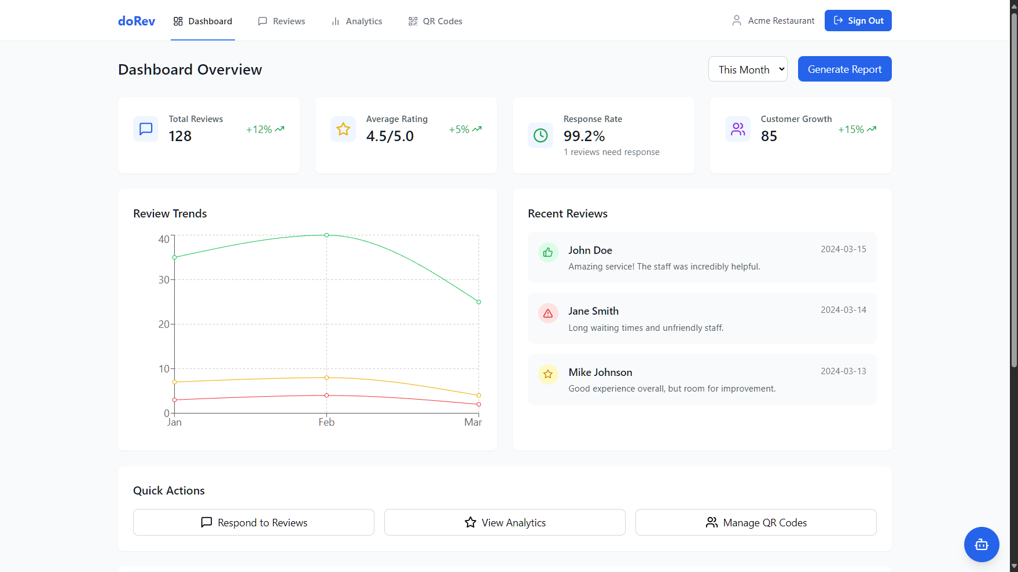
Implementation
Fig. 1: (Sign In Page)
Fig. 2: (Owners Dashboard)
Notes:
12
12

Slide 13
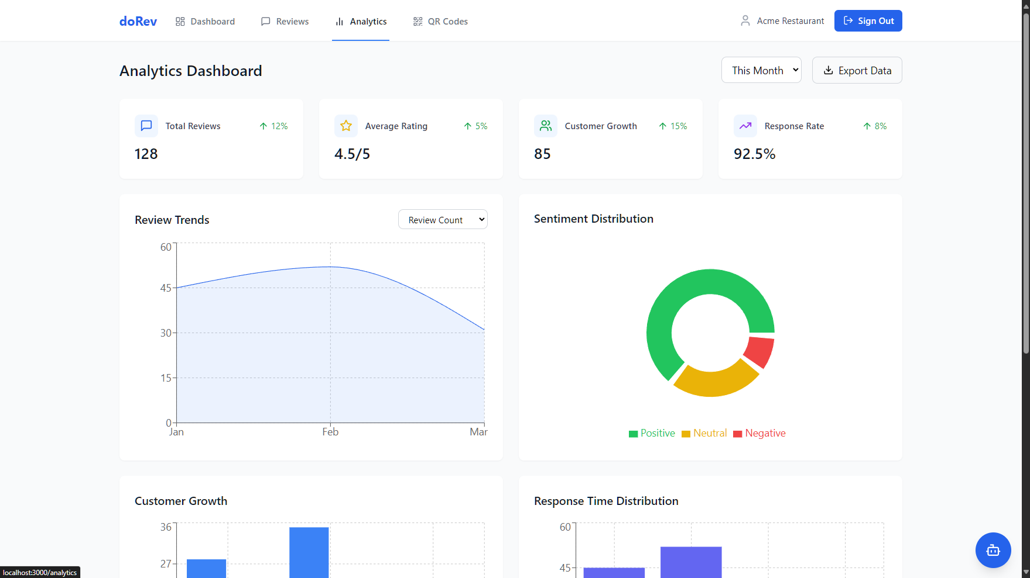
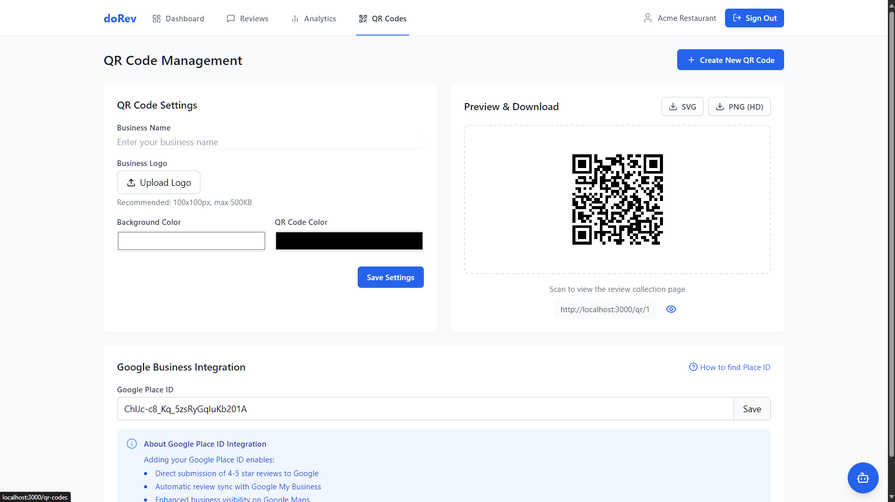
Fig. 3:
(Analytics Dashboard)
Fig. 4:
(QR code Management)

Slide 14
Conclusion
AI Google Review Manager helps businesses handle customer feedback more easily and smartly. It uses AI and sentiment analysis to highlight useful reviews and hide harmful ones, keeping the brand image strong. With real-time stats, filters, and a dashboard, it gives clear insights and helps businesses improve services based on data..
Notes:
14
14

Slide 15
References
[1] Vimolboon Cherapanukorn and Phasit Charoenkwan,Word Cloud of Online Hotel Reviews in Myanmar for Customer Satisfaction Analysis,November 2021
https://ieeexplore.ieee.org/document/8113286
[2] Marija Stojchevska, Andreja Naumoski, Kosta Mitreski,
Modelling the Impact of Hotel Facilities on Online Hotel Review Score for City of Skopje, December 2022 https://ieeexplore.ieee.org/document/8567317
[3]Yan Jiang,Restaurant Reviews Analysis Model Based on Machine Learning Algorithms, august 2023,
https://ieeexplore.ieee.org/document/10704184
Notes:
15
15

Slide 16
Thank You...!!
Notes:
16
16

